Slide 1

Machine Learning Trading Strategy
Data Bootcamp Final Project
Dennis, Ivan, Eilon

Slide 2
Prediction Task & Goal
Directional Prediction Task
Comparing Models Fairly
From Predictions to Trades
01
02
03
The goal is to predict whether a stock’s next day return is up or down. We frame this as a classification problem instead of forecasting prices directly, since short-term prices are noisy and direction is more useful for trading decisions.
We test several machine learning models using the same data, features, and time split. This way, differences in performance come from the models themselves rather than changes in the setup.
Rather than stopping at accuracy metrics, we plug model predictions into a simulated trading strategy to see how they actually affect portfolio performance.

Slide 3
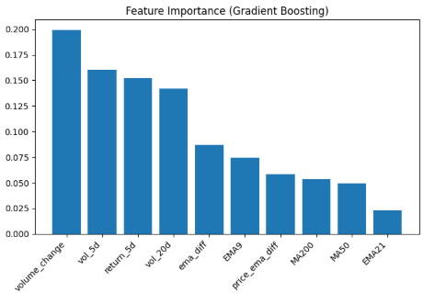
Data Source
Data & Feature Construction
Feature Construction
Train Test Setup
We use daily price and volume data for Nasdaq 100 stocks, including open, high, low, close, and volume. The dataset spans roughly two years per ticker and focuses on large, liquid equities to reduce noise from illiquidity.
Features are designed to capture short term momentum, trend, volatility, and volume behavior. These include moving averages, short horizon returns, rolling volatility, and volume changes. All features are built strictly using historical data.
Each stock is processed independently and the final dataset is ordered by time. A time-aware train test split is used instead of random sampling to avoid look-ahead bias and better reflect real world forecasting.

Slide 4
Models & Evaluation
Evaluation Setup
Logistic Regression
Random Forest
Gradient Boosting
Same features and time-based train/test split for all models
Models evaluated using Accuracy, Recall, F1, and ROC-AUC
Recall and probability quality emphasized for trading use
Always-up benchmark included to separate model skill from market drift
Linear classification model
Provides stable probabilistic estimates
Useful reference point for more flexible models
Tree-based ensemble capturing nonlinear effects
More flexible than logistic regression
Performance varied across market regimes
Strongest overall performance across metrics
Best balance of recall and F1
Most reliable probability outputs
Selected for use with trading stratergy

Slide 5
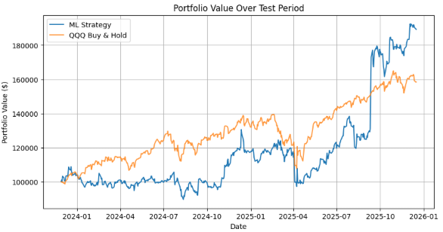

Results & Performance
Equity curve: ML strategy vs QQQ buy-and-hold
The model-driven strategy finishes noticeably above a simple QQQ buy-and-hold over the test period, even though individual predictions are a bit noisy.
Result interpretation:
Gains driven by confidence-weighted position sizing
Stronger performance during trending market periods
Larger drawdowns due to concentrated exposure
Risk-adjusted performance ends up being similar to QQQ, with higher volatility coming from more aggressive exposure when the model has high conviction.

Slide 6
Key takeaways
Limitations
Next steps
Conclusions & Next Steps
01
02
03
We did not include transaction costs or slippage, which would likely reduce real-world performance
Execution is simplified and assumes fills at observed prices
Results are based on a single test period and could change in different market conditions
Test the strategy with realistic execution, including transaction costs and slippage
Reconnect to a paper trading environment to observe live behavior and constraints
Refine position sizing and thresholds based on execution and risk behavior
Model choice matters, but execution and position sizing matter more
Probabilistic signals are more flexible than fixed trading rules
Portfolio construction has a larger impact than raw prediction accuracy
The midterm revealed how rigid rule-based strategies can be, motivating the shift to model-driven probabilities

